Slide 1

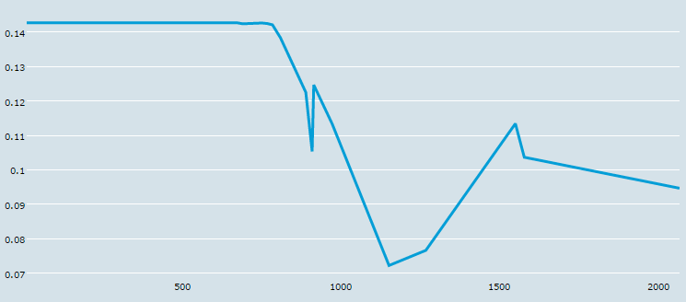
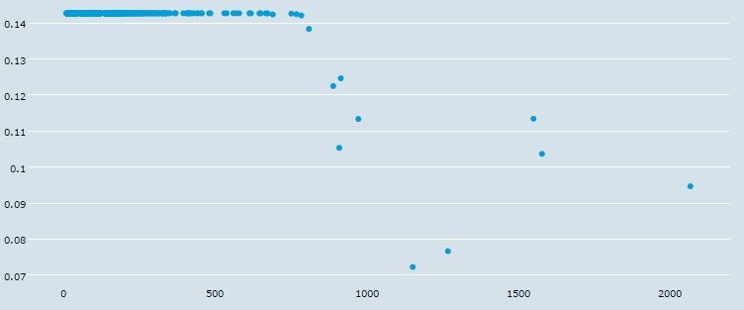
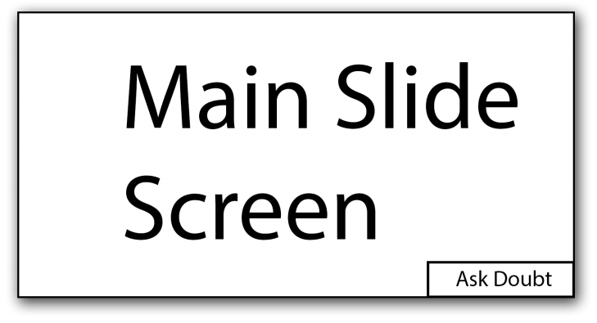
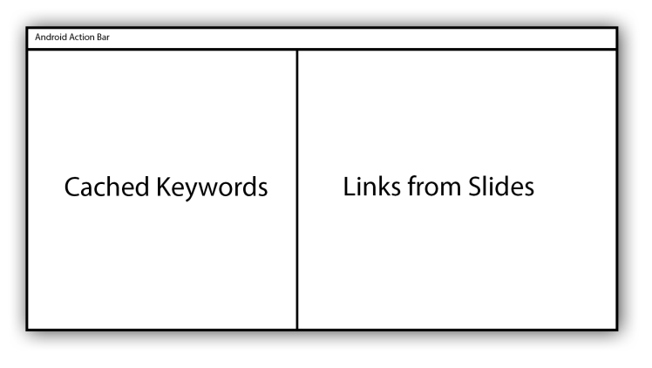
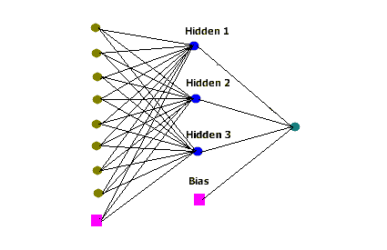
Smart Class Room
Abhishek Sarkar and Kartheek Nagelli (Working under Dr. Samit Bhattacharya)
abhishek.sarkar@iitg.ernet.in, n.kartheek@iitg.ernet.in
Department of CSE, Indian Institute of Technology Guwahati, Assam.
Abstract
Ubiquitous Computing
Data Analysis cont.
Future Work
Smart classroom is an application based on calm technology to demonstrate the use of ubiquitous computing in a classroom environment. We have
decided on implementing the following features:
Smart doubt processing before it is presented to instructor.
Showing relevant data in real time as slides are being taught.
Cached set of related keywords for the students to explore.
In this term we have implemented a classifier based on the artificial neural networks and used question headers along with votes from stackoverflow.com to test its performance. Also we have read through several papers on calm technology, ubiquitous computing and pervasive technology to understand them well. Because our final application will have users handling multiple devices at a time, we have gone through papers on how the eye follows through all these screens.
Ubiquitous computing is a concept where computing is made to appear everywhere and anywhere. In contrast to desktop computing, ubiquitous computing can occur using any device, in any location, and in any format. A user interacts with the computer, which can exist in many different forms, including laptop computers, tablets and terminals in everyday objects such as fridge or a pair of glasses. The underlying technologies to support ubiquitous computing include internet, advanced middleware, operating system, mobile code, sensors, microprocessors, new I/O and user interfaces, network, mobile protocols, location and positioning and new materials.
their higher votes. The second kind got weights from medium to highest, while the third kind were the ones with the highest relative classification figures.
With the above tools ready we will focus on the implementation aspects of the final application.
We will have a central server controlling all other devices connected to that network. Below is a rough idea of app design for two screens.
Doubt Asking
Students alert the professor using some audio notification. We plan to enable audio commands for the students to send and start typing the doubts.
Slide/Keyword Processing
All slides will be processed as soon as they are uploaded on the central server. All the links and technical keywords related to the topic will be parsed and kept ready for the student to view directly when that slide is being taught.
NN-Back propagation Classifier
We crawled through about 7500 questions from stackoverflow.com and collected their headers and votes. The topic chosen was “android”. Now we preprocessed the data to identify all the unique words. During training we give to the first layer a key value pair as input. The key value being the unique word and the value being its frequency in the question. Our tree has two hidden layers with 4 nodes each and one output layer with a single node which classifies the question. We added a bias to classify cases where given question has no words in common with the training data.
Line and Scatter Plot for our data
Visual attention
Introduction
As per [1] for multiple screens the visual attention is based on 6 factors :
1)Discovery time (DT):It is defined as time required by the viewer to make a pass over all the screens so that each screen has been fixated visually at least once.
2)Discovery sequence(DS):It is defined as sequence of screens that was traversed by the viewer’s eye gaze during the discovery time.
3)Screen watching time(SWT): It is the percentage of attention devoted by viewers to each screen during the monitoring time interval.
4)Transition count(TC):It is defined as number of eye gaze transitions between consecutively fixated screen that occurred during the monitoring time interval.
5)Eye gaze travel distance(EGTD): It represents the total distance travelled by the viewer’s eye gaze during the monitoring time interval expressed in units reported by the eye tacking equipment.
6)Switch time(ST):It is defined as percentage of time during which eye gaze travels between screens.
In [1] they have quantified these 6 factors and shown the way to calculate these terms.
Smart classroom is an application that uses the easy access that students these days have to smart devices to bring a richer classroom experience. Utmost care has been taken to not hamper the natural classroom behaviour of the students or the instructor when using the application. We provide
simpler, smarter interaction mechanisms between the instructor and the students, along with smarter presentation of the age old course slides
A typical ANN is shown alongside
Conclusion
Calm Technology
So in this term we have familiarized ourselves with the topics calm technology and ubiquitous computing. We have also researched how the human eye works in the presence of multiple screens . We came up with a classification scheme for questions and their relevance to a given topic and also implemented it. And finally we have done a theoretical design of our final application.
Calm technology is a type of information technology where the interaction between the technology and its user is designed to occur in the users periphery rather than constantly at the centre of attention. Information from the technology shifts to the users attention when needed but otherwise stays calmly in the users periphery.
The users attention to the technology must reside mainly in the periphery. This means that either the technology can easily shift between the centre of attention and the periphery or that much of the information conveyed by the technology is present in the periphery rather than the centre.
Data Analysis
The nature of the data we collected was particular. The questions with highest votes had concise headers with more technical terms. And headers for lower voted ones were more descriptive. On analyzing the data we found that three categories, one with better votes yet very less recurring words with the rest of the dataset, ones with lower votes and recurring words like “the”, “for”, “android” etc., and finally those with higher votes and also recurring words. The first kind got placed inspite of
References
[1] Visual Attention Measures for Multi-Screen TV by Radu-Daniel Vatavu & Matei Mancas, 2014
[2] Visual attention within and around the field of focal attention: A zoom lens model by CW Eriksen & JDS James, 1986, Springer.
[3] Roberto Martinez-Maldonado, Yannis Dimitriadis, Andrew Clayphan,Juan A. Munoz Cristobal, Luis P. Prieto, Maria Jesus Rodriguez-Triana, and Judy Kay. Integrating orchestration of ubiquitous and pervasive learning environments., 25th Australian Computer Human Interaction Conference: Augmentation, Application, Innovation,2013
[4] NLP Programming Tutorial, by Graham Neubig, NAIST.
[5] Introduction to Data Mining, by Pang-Ning Tan, Vipin Kumar.

